Slide 1

Lifetime KPI – All Versions

Slide 2
Lifetime KPI – WW Version

Slide 3
Unless stated otherwise, all analysis is based on United States iOS.

Slide 4
iOS Retention
Update | Day 1 iTunes | Day 2 iTunes | Day 3 iTunes | Day 4 iTunes | Day 5 iTunes | Day 6 iTunes | Day 7 iTunes | Day 8 iTunes | Day 9 iTunes | Day 10 iTunes | Day 11 iTunes | Day 12 iTunes | Day 13 iTunes | Day 14 iTunes | Day 15 iTunes | Day 16 iTunes | Day 17 iTunes | Day 18 iTunes | Day 19 iTunes | Day 20 iTunes | Day 30 iTunes |  | Downloads
Launch | 43% | 32% | 27% | 25% | 23% | 22% | 22% | 20% | 19% | 18% | 18% | 17% | 17% | 17% | 16% | 16% | 15% | 15% | 15% | 15% | 13% |  | 1,367,584
Update 1 | 44% | 32% | 28% | 26% | 24% | 23% | 23% | 21% | 20% | 20% | 19% | 19% | 19% | 18% | 18% | 17% | 17% | 17% | 16% | 16% | 14% |  | 342,721
Update 2 | 44% | 31% | 26% | 24% | 22% | 21% | 20% | 19% | 18% | 17% | 17% | 16% | 16% | 16% | 15% | 15% | 14% | 14% | 14% | 14% | 12% |  | 269,794
Update 3 | 44% | 32% | 27% | 25% | 23% | 22% | 22% | 20% | 20% | 19% | 18% | 18% | 18% | 17% | 17% | 16% | 16% | 16% | 15% | 15% | 13% |  | 257,120
Update 4 | 45% | 34% | 31% | 29% | 27% | 26% | 26% | 25% | 24% | 23% | 23% | 22% | 22% | 22% | 22% | 21% | 21% | 21% | 20% | 20% | 18% |  | 121,726
Update 5 | 46% | 35% | 32% | 29% | 28% | 27% | 27% | 26% | 25% | 24% | 23% | 23% | 23% | 23% | 22% | 21% | 21% | 21% | 21% | 21% | 18% |  | 80,326
Update 6 | 47% | 36% | 33% | 31% | 30% | 29% | 28% | 27% | 27% | 26% | 25% | 25% | 25% | 25% | 24% | 24% | 23% | 23% | 23% | 23% | 21% |  | 67,229
Update 7 | 45% | 33% | 29% | 27% | 25% | 25% | 24% | 23% | 22% | 21% | 21% | 20% | 20% | 20% | 19% | 19% | 19% | 18% | 18% | 18% | 16% |  | 555,861
Update 8 | 43% | 32% | 28% | 26% | 25% | 24% | 23% | 22% | 21% | 21% | 20% | 20% | 20% | 20% | 19% | 19% | 18% | 18% | 18% | 18% | 16% |  | 166,988
Update 9 | 45% | 33% | 29% | 26% | 24% | 23% | 23% | 22% | 20% | 20% | 19% | 19% | 18% | 18% | 18% | 17% | 17% | 16% | 16% | 16% | 13% |  | 279,521
Update 10 | 43% | 32% | 27% | 25% | 23% | 23% | 22% | 21% | 20% | 19% | 19% | 18% | 18% | 18% | 18% | 17% | 17% | 16% | 16% | 16% | 14% |  | 146,626
Update 11 | 42% | 32% | 28% | 26% | 25% | 24% | 23% | 22% | 21% | 21% | 20% | 20% | 20% | 19% | 19% | 19% | 18% | 18% | 18% | 18% | 15% |  | 136,389
Update 12 | 44% | 33% | 28% | 26% | 24% | 23% | 22% | 21% | 20% | 20% | 19% | 19% | 19% | 19% | 18% | 18% | 18% | 19% | 19% | 19%

Slide 5
Google Play Retention
Update | Day 1 GP | Day 2 GP | Day 3 GP | Day 4 GP | Day 5 GP | Day 6 GP | Day 7 GP | Day 8 GP | Day 9 GP | Day 10 GP | Day 11 GP | Day 12 GP | Day 13 GP | Day 14 GP | Day 15 GP | Day 16 GP | Day 17 GP | Day 18 GP | Day 19 GP | Day 20 GP | Day 30 GP |  | Downloads
Launch | 42% | 30% | 25% | 22% | 21% | 20% | 19% | 17% | 17% | 16% | 15% | 15% | 14% | 14% | 14% | 13% | 13% | 12% | 12% | 12% | 10% |  | 971,023
Update 1 | 37% | 25% | 20% | 18% | 16% | 15% | 15% | 14% | 13% | 12% | 12% | 11% | 11% | 11% | 10% | 10% | 10% | 10% | 9% | 9% | 8% |  | 317,416
Update 2 | 36% | 23% | 18% | 16% | 15% | 13% | 13% | 12% | 11% | 11% | 10% | 10% | 9% | 9% | 9% | 8% | 8% | 8% | 8% | 8% | 6% |  | 315,190
Update 3 | 38% | 25% | 20% | 18% | 16% | 15% | 15% | 14% | 13% | 12% | 12% | 11% | 11% | 11% | 11% | 10% | 10% | 10% | 9% | 9% | 8% |  | 176,224
Update 4 | 41% | 29% | 25% | 22% | 21% | 20% | 20% | 19% | 18% | 17% | 17% | 16% | 16% | 16% | 16% | 15% | 15% | 14% | 14% | 14% | 12% |  | 74,683
Update 5 | 40% | 28% | 24% | 22% | 20% | 19% | 19% | 18% | 17% | 16% | 16% | 16% | 15% | 15% | 15% | 14% | 14% | 14% | 14% | 14% | 11% |  | 109,368
Update 6 | 37% | 25% | 21% | 18% | 17% | 16% | 16% | 15% | 14% | 14% | 13% | 13% | 12% | 12% | 12% | 11% | 11% | 11% | 11% | 10% | 9% |  | 118,752
Update 7 | 35% | 23% | 19% | 16% | 15% | 14% | 13% | 13% | 12% | 11% | 11% | 11% | 11% | 11% | 10% | 10% | 9% | 9% | 9% | 9% | 8% |  | 263,902
Update 8 | 38% | 26% | 22% | 20% | 18% | 17% | 17% | 16% | 15% | 14% | 14% | 14% | 13% | 13% | 13% | 12% | 12% | 12% | 12% | 12% | 10% |  | 142,622
Update 9 | 40% | 27% | 22% | 20% | 19% | 18% | 17% | 16% | 15% | 14% | 14% | 14% | 13% | 13% | 12% | 12% | 12% | 12% | 11% | 11% | 9% |  | 204,590
Update 10 | 36% | 26% | 22% | 20% | 19% | 18% | 17% | 16% | 16% | 15% | 15% | 14% | 14% | 14% | 14% | 13% | 13% | 13% | 12% | 13% | 11% |  | 100,167
Update 11 | 38% | 26% | 22% | 20% | 18% | 18% | 17% | 16% | 15% | 15% | 14% | 14% | 14% | 13% | 13% | 12% | 12% | 12% | 12% | 12% | 10% |  | 123,173
Update 12 | 37% | 25% | 21% | 18% | 17% | 16% | 15% | 14% | 13% | 13% | 12% | 11% | 11% | 11% | 10% | 10% | 9% | 9% | 9% | 9%

Slide 6
SAMPLE

Slide 7
Downloads & DAU

Slide 8
New PAU & PAU

Slide 9
New CSR & CSR

Slide 10
IAP Revenue & IAP Revenue per User

Slide 11
Ad Revenue & Ad Revenue per User

Slide 12
ARPPU

Slide 13
Permanent Characters (non-premium)
 | Character | Average Sessions
Act 1 | Hamm | 3.68
 | Jessie | 10.15
 | Bo_Peep | 37.1
 | Sarge | 16.7
 | Woody | 1.63
Act 2 | Buzz_Lightyear | 16
 | Pete | 75.79
 | Daisy | 21.94
 | Sulley | 30.16
 | Mike_Wazowski | 45.84
 | Eve | 156.62
 | Celia_Mae | 21.15
 | Roz | 65.03
Act 3 | Minnie_Mouse | 20.16
 | Rapunzel | 31.2
 | Aurora | 25.97
 | Flora | 35.98
 | Mother_Gothel | 96.17
 | Prince_Phillip | 37.15
 | Donald | 187.09
 | Randall_Boggs | 43.64
 | Fauna | 39.2
 | Flynn | 60.16
 | Zurg | 77.8
Other | Cinderella | 58.2
 | Prince_Charming | 43.89
 | Will_Turner | 42.17
 | Elizabeth_Swann | 67.74
 | Chip | 37
 | Dale | 21
 | Merlin | 6.91

Slide 14
Mega Event Characters (non-premium)
 | Character | Average Sessions
Incredibles | Dash | 5.76
 | Mr_Incredible | 5.72
 | Syndrome | 6.75
 | Violet | 5.19
NBC | Jack_Skellington | 18.60
 | Oogie_Boogie | 20.47
 | Sally | 19.07
Frozen | Anna | 15.31
 | Elsa | 27.71
 | Hans | 9.89
 | Kristoff | 28.66
Mulan | Li_Shang | 19.10
 | Mulan | 17.20
B&B | Beast | 6.81
 | Belle | 25.94
 | Cogsworth | 11.65
 | Gaston | 14.65
 | Lumiere | 19.14
NOTE: strange results for Incredibles characters, in particular Dash
Some characters available in IAP bundles
Only includes characters summoned during the event

Slide 15
Sessions and Characters (non-premium)
Sessions per character initially is rising but then stabilizes around 5.9
Sessions per day peaks at 15 characters
Note: This does not include premium characters

Slide 16
DAU by Act

Slide 17
Sessions to Complete Act
Act | Users | PAU | Avg. Sessions
1 | 337,512 | 98,070 | 87
2 | 169,738 | 75,668 | 285
3 | 67,744 | 37,855 | 466

Slide 18
Tutorial Churn Points
A
B
C
D
E
Tutorial quests with low completion rates: A) A handy man (82%), B) Toy Time (86%), C) Bring music to the world (82.5%), D) Ladies’ Choice (74%), E) Welcome a wizard (86.6%)
Most poor completion rates are for quests with long timers
Besides A and C

Slide 19
Tutorial Churn Points
A Handy Man
Large churn point around ‘A Handy Man’
- Fairly gradual decline in activation rates besides the large drop between ‘A Place to Plan’ and ‘Make a Plan’
Second largest churn point is ‘Toy Time’
16.8% of DNU complete the entire tutorial flow

Slide 20
Tutorial Churn Points: A Handy Man
Let the Fun Begin
Activate: 458,058
Complete: 97.5%
% DNU to Activate: 73.0%
Be a Good Neighbor
Activate: 434,309
Complete: 98.5%
% DNU to Activate: 69.2%
A Place to Plan
Activate: 420,760
Complete: 95.4%
% DNU to Activate: 67.1%
Make a Plan
Activate: 353,739
Complete: 99.3%
% DNU to Activate: 56.4%
A Handy Man
Activate: 443,657
Complete: 82.2%
% DNU to Activate: 70.7%
‘A Handy Man’ creating a churn point which is reducing the amount of users that are moving on to ‘Make a plan’
- None of these quests have long timers but ‘A Handy Man’ is a two step quest

Slide 21
Retention and User Actions
All features besides Friend Visits have a slight upward trend as the user returns to play
Visit a friend starts off with a high usage rate but by Day 50 only 10.8% of users use this feature

Slide 22
Social Use
Only a small minority of DAU use the visit friend feautre
As players spend more time in the game they are less likely to use this feature

Slide 23
Friend Visits and Currency Collection
Not all friend visits are intentional. Only 70% of DAU to visit a friend end up collecting currency.
This rate is better for user with real friends but still it appears that ~80% of visits are intentional

Slide 24
Parades
Parade use per DAU is trending slightly higher
- Parade use does not diminish as users play the game more
 | Happiness Levels
 | Level 0 | Level 1 | Level 2 | Level 3 | Level 4
Percent of DAU | 23.1% | 25.3% | 27.5% | 23.9% | 0.2%
Average Users | 36,734 | 39,999 | 43,698 | 37,973 | 301

Slide 25
Floats
Float | Users
SensationalSixFloat | 1,195,788
ToyStoryFloat | 619,772
WallEFloat | 260,813
SleepingBeautyFloat | 241,377
CinderellaFloat | 161,874
MonstersIncFloat | 151,463
TangledFloat | 122,683
Pirates of the Caribbean Float | 97,313
ZootopiaFloat | 54,110
BeautyandtheBeastFloat | 46,341
FrozenFloat | 39,123
Mulan Float | 32,551
NightmareBeforeChristmasFloat | 26,032
Incredibles Float | 19,169
Float | Starts
SensationalSixFloat | 16,631,821
ToyStoryFloat | 15,518,823
WallEFloat | 13,370,691
CinderellaFloat | 11,240,509
SleepingBeautyFloat | 11,227,064
TangledFloat | 9,959,235
MonstersIncFloat | 7,467,989
Pirates of the Caribbean Float | 5,580,449
FrozenFloat | 5,026,733
BeautyandtheBeastFloat | 3,874,406
NightmareBeforeChristmasFloat | 3,446,619
Incredibles Float | 2,791,422
Mulan Float | 2,781,097
ZootopiaFloat | 1,426,829
Float | Users
Slot2 | 377,326
Slot3 | 130,189
Slot4 | 61,178
Slot5 | 26,711
Slot6 | 9,321
Slot7 | 5,751
Story floats are most used and owned
Some Time Limited floats are amongst the most bought and owned
Sharp decline in slots purchased after the user has 3 slots
-they start to cost gems

Slide 26
Merlin’s Spells
Spell use by Happiness Rank
Happiness Level | HappinessBoost | HappinessShield
0 | 393 | 1,609
1 | 742 | 2,644
2 | 3,558 | 6,255
3 | 10,801 | 8,297
4 | 112 | 5,086
Collect Spell is the most used spell with the majority of users with merlin using the spell at least once per day
Happiness boost and shields are rarely used
- Players are more likely to use gems to skip the collect magic timer
Spend HC Average per DAU
HappinessBoost | Shield | Collector | Total
0.0012 | 0.0019 | 0.0038 | 0.0069

Slide 27
Merlin’s Spells: Collect Spell
Players can watch an ad to skip the collect magic timer
- Ad point cut sees little use but there were two large spikes in usage

Slide 28
Retention and Mega Events
Graph: percent of users to return for all 7 days following their install
No positive relationship between 7 day return rate and mega events for new users

Slide 29
Retention, Conversions and Mega Events
Graph: percent of users to return for all 7 days following their first purchase
Positive relationship between conversion date and 7 day return rate for mega events
large spike for users that convert on first day of event
Some events have large spikes in retention after chapters are unlocked

Slide 30
DEMOGRAPHICS & REVENUE
Our core demographic is female users, making up 72% of our user base and 79% of lifetime revenue.
Despite only being 11% of our user base, women age 25-34 make up 27% of revenue being the most profitable group by far.
* iOS, US only

Slide 31
DEMOGRAPHICS & REVENUE
Older players with more disposable income are more willing to spend money in the game; in particular, women over age 25 are our largest spenders.
Future user acquisition campaigns should focus have a larger focus on these demographics to maximize profitability.
* iOS, US only

Slide 32
PAU COHORTS
Even though DMK is relatively casual, Whales still make up the largest share of our revenue. Despite only making up only 6% of PAU, they contribute 40% of revenue.
Whale 1 cohort (€150 - €500) alone makes up €2.6M (or 29% of lifetime revenue); overshadowing our second most profitable group – Minnow 3 (€25 - €60) which makes €1.2M.
* iOS, US PAU only

Slide 33








PAU COHORTS
Minnows (€0.1 - €60)
Minnow 1 (€0.1 - €10)
Current Level: 21
Unique Days Played: 43
Transactions: 1
Net Revenue: €3.67
Minnow 2 (€10 - €25)
Current Level: 28
Unique Days Played: 87
Transactions: 4
Net Revenue: €15.58
Minnow 3 (€25 - €60)
Current Level: 32
Unique Days Played: 131
Transactions: 9
Net Revenue: €37.86
Dolphins (€60 - €150)
Dolphin 1 (€60 - €100)
Current Level: 35
Unique Days Played: 168
Transactions: 16
Net Revenue: €75.95
Dolphin 2 (€100 - €150) Current Level: 36
Unique Days Played: 184
Transactions: 23
Net Revenue: €120.57
Whales (€150 - €1000)
Kraken (>€1000)
Whale 1 (€150 - €500)
Current Level: 37
Unique Days Played: 191
Transactions: 37
Net Revenue: €223.73
Whale 2 (€150 - €500)
Current Level: 38
Unique Days Played: 209
Transactions: 68
Net Revenue: €652.65
Kraken (> €1000)
Current Level: 38
Unique Days Played: 210
Transactions: 100
Net Revenue: €1401.85

Slide 34
FIRST CONVERSIONS
The Pluto Starter Bundle is responsible for a large share of first conversions, making up 28% of all first conversions. This is followed by the Gem Pack 1 ($1.99), making up 16% of first conversions.
Players generally decide whether to pay into the game fairly early, with about 31% of first conversions occurring between level 5-7; roughly around missions Cheer Up Pete pt.3 and Glistening Gloves.
* iOS, US PAU only

Slide 35
WHY DO PAYING PLAYERS CHURN?
Quest difficulty
Welcoming quests are relatively more time consuming and are common points of churn. In particular for less engaged players, “Welcome a Prince” is a very common churn point; while the “Welcome a Police Officer” is more common among more engaged players.
* iOS, US PAU only

Slide 36
WHY DO PAYING PLAYERS CHURN?
Out of Currency
Players that churn generally exhibit a much lower currency balance, especially in terms of magic. Amongst churn users, 56% of users had less than 25,000 magic while only 20% had such a low balance. This suggests that players are running out of currency to progress through the game, and therefore quitting.
* iOS, US PAU only

Slide 37
WHY DO PAYING PLAYERS CHURN?
Age
There is some mild correlation between age and likeliness to churn. As players get older, they are slightly less likely to quit. Noticeably, age group 13-18 has the lowest churn rate by a large margin.
* iOS, US PAU only

Slide 38
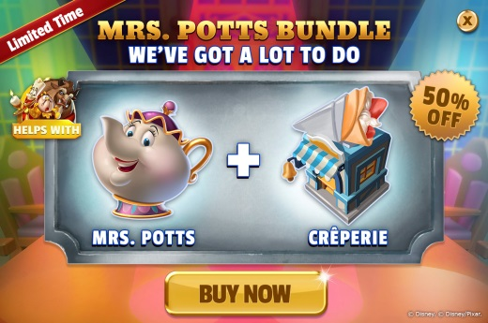
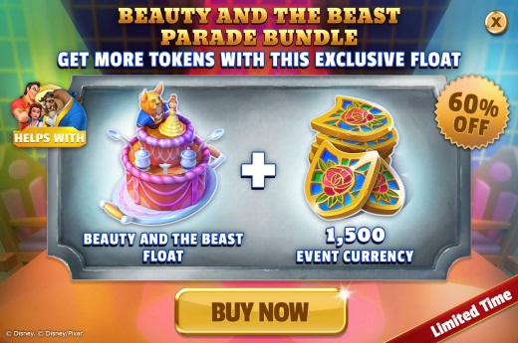
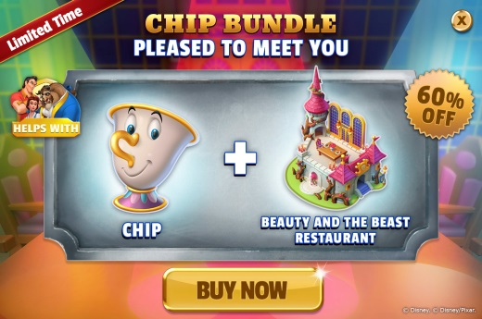
MEGA EVENT BUNDLES
Every Mega Event (except The Incredibles) has 3 premium content bundles and we have made them increasingly attractive over time.
As a share of all bundle purchasers, users that end up purchasing all 3 bundles increased from 17% during Nightmare Before Christmas to 35% during Beauty & the Beast.
* iOS, US PAU only

Slide 39
MEGA EVENT BUNDLES – PREMIUM CHARACTER BUNDLE
The first premium character bundle in each update is particularly popular. Among players that purchase a Mega Event bundle, around 80% of ME bundle will buy the premium character bundle with the exception of Olaf during Frozen.
* iOS, US PAU only

Slide 40
ENGAGEMENT – DAILY PLAYTIME
Daily playtime increases sharply when Mega Events are active. In particular, players in upper paying cohorts exhibit a high rate of increase of playtime.
Daily playtime is proportional to PAU cohort, with NPAU playing the least and Krakens (lifetime expenditure >€1000) playing the most. This highlights the relationship between player engagement and willingness to pay.
*iOS, US only; 2016-03-16 to 2017-07-25 *Only top 2 and bottom 1 cohorts results were shown.

Slide 41
ENGAGEMENT – DAILY SESSION
Mega Events also correlate with increased daily sessions although the rate of increase is not the same amongst PAU cohorts.
Dolphin 1 (lifetime spending €60 - €100) had the most daily sessions despite not spending the most time in game. This means that these mid-tier players will login more often, but play comparatively less per session than upper PAU cohorts.
NPAU spent the least time in game regardless of any special events.
*iOS, US only; 2016-03-16 to 2017-07-25 *Only top 2 and bottom 1 cohorts results were shown.

Slide 42
ORGANIC INSTALLATIONS
Currently, around 72.16% of daily downloads is organic.
Facebook and Applifier make the biggest contributions in terms of external user acquisition.
*iOS, US only; 2016-03-16 to 2017-07-31*Only top 2 results were shown.

Slide 43
CRASH
1
2
Crashes on Google Play devices are more frequent than iOS devices, although there are twice as many Google Play devices.
The first big crash period on Google Play happened between (1) 7/22/2016 and 9/15/2016, and (2) 4/14/2017 to 5/25/2017. Despite the crashes, daily gross revenue was largely unaffected.
*US only; 2016-03-16 to 2017-07-25

Slide 44
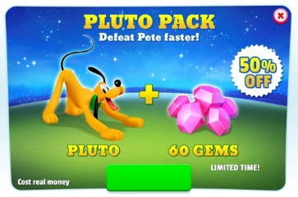
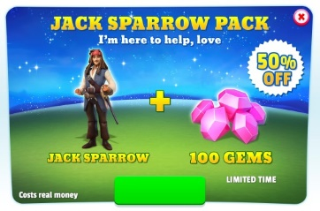
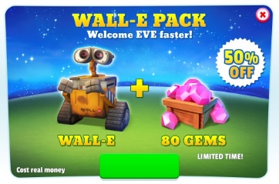
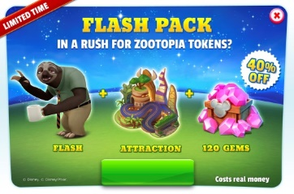
1st ITEM PURCHASED AFTER PURCHASING GEMS BUNDLE
Buy PlutoHouse
Unlock ParadeFloatSlot2
Unlock GatchaSolvingSlot2
Buy The Kraken
Buy Pirates of the Caribbean Float
Skip Bronze Chest
Buy Wall-E House
Buy Mike and Sulley to the Rescue
Skip Bronze Chest
Buy Zootopia Float
Skip Bronze Chest
Skip Judy Hopps
After purchasing character bundles, the bundled gems are most often spent on attractions (22.72%) or floats (3.79%) for that IP/character; highlighting that these gems are predisposed to being spent right away.
It is therefore important that there is an obvious sink for the gems in the form of relevant attractions or floats, for future character bundles as well.
Bronze chest skips (4.11%) are surprisingly also a common sink for bundled gems.
*iOS, US only; 2016-03-16 to 2017-07-25

Slide 45
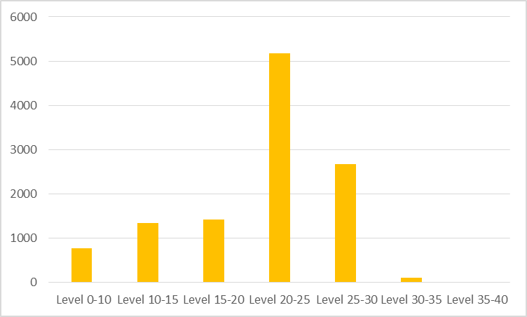
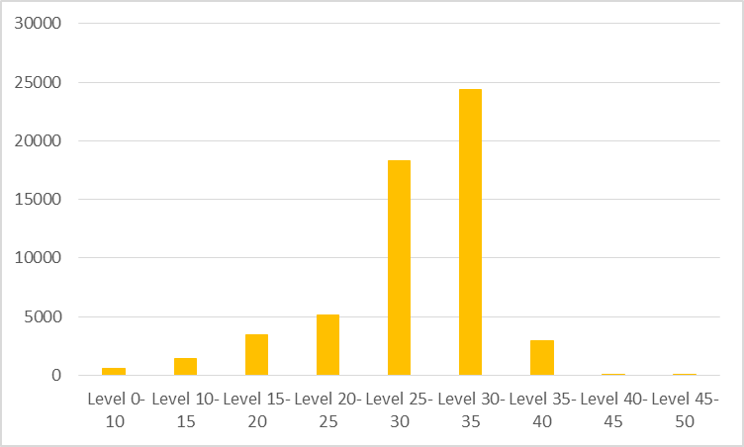
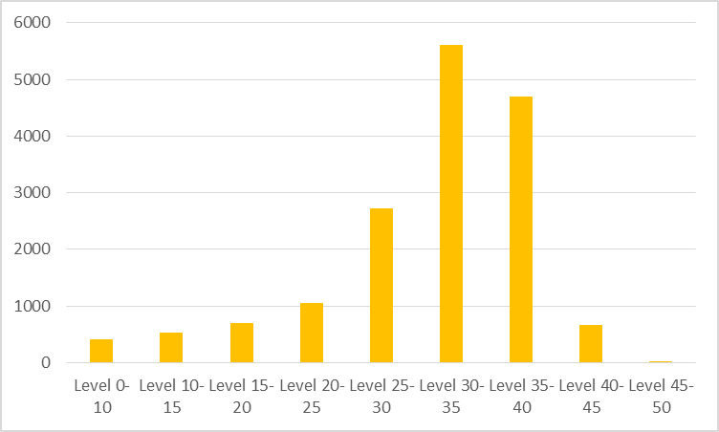
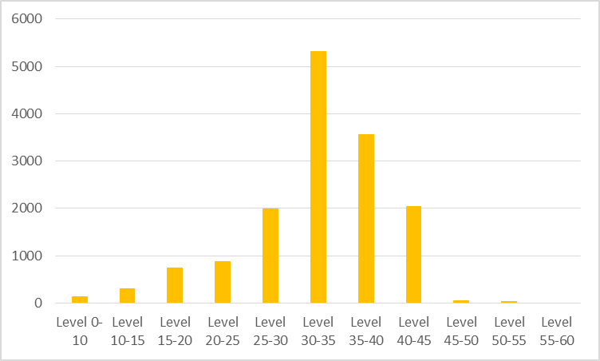
CURRENCY SPENT
Number of users buying attractions during above sales：
Mother’s Day Sale
Attraction Sale 50% Off
New Year Sale
Attraction Sale 30% Off
Sale days make up most of the gem spent, and the Sales in Attractions are more attractive to players.
Compared to the other days, the 50% Off Sales increases gem spending by more than 2 times compared to other sales day.
Middle level players (lv 25-35) is the biggest consumer group during all attraction sales. Personalized welcome screen sales could be introduced to future updates.
*iOS, US only; 2016-03-16 to 2017-08-01

Slide 46
CURRENCY SPENT
During Mega Events (e.g. Update 7, 9, 12), there is a massive increase in both free and purchased gems spent on characters.
The Frozen and Beauty & the Beast Mega Event had a higher ratio of purchased-free gems than other events. The popularity of these IPs incentivized many IAP and corresponding purchased gems.
*iOS, US only; 2016-09-14 to 2017-08-01

Slide 47





USER ENGAGEMENT: DAILY OVERVIEW
User engagement is highly sensitive towards content releases, which includes game updates, and Mega Events.
Engagement is barely changed when considering other Live Ops though (i.e. Promos and Mini-Events).
Impact Recap:
Update Release: Large increase of time played with lower impact on sessions, for a short period.
Mega Events: Large increase of time played and sessions for the entire period.
Mini-Events: Small increase on both time played and sessions.
Promos: Decrease on both time played and sessions.
Launch
Up 1
Sleeping Beauty
Up 2
Incredibles ME
Up 3
Cinderella;
Gacha Chests
Up 4
Pirates
Up 5
NBC ME;
Costumes
Up 6
Up 7
Frozen ME
IP Chests
Up 8
Mulan ME
Up 9
BtB ME
Merlin Spells
Up 10
Merlin Cauldron
Up 11
Zootopia

Slide 48
USER ENGAGEMENT: UPDATES OVERVIEW
Comparing the performance between updates, it is clear that Mega Events drive both sessions and time played up.
Nonetheless, new features also impact the data on the long run, as seen with the Up5 Gacha, and Up10 Merlin Spells.
Noteworthy impact:
Update 3: The release of Gacha feature increased session length, as players need to search throughout the park for the free chests.
Update 5: NBC Mega Event had a shorter update period (5 days without it active)
Update 10: The new Merlin Collection Spell reduced session length considerably.
Launch
Up 1
Sleeping Beauty
Up 2
Incredibles ME
Up 3
Cinderella;
Gacha Chests
Up 4
Pirates
Up 5
NBC ME;
Costumes
Up 6
Up 7
Frozen ME
IP Chests
Up 8
Mulan ME
Up 9
BtB ME
Merlin Spells
Up 10
Merlin Cauldron
Up 11
Zootopia

Slide 49
USER ENGAGEMENT: LIVE OPERATIONS OVERVIEW
AVERAGE DAILY TIME PLAYED (minutes)
Live Ops impact is consistent throughout all cohorts:
Mini-Events: do not have a significant impact on overall user engagement.
Mega Events: the key feature to increase overall engagement.
IAP and Legendary Promos: no significant impact.
ITEM Promos: slight increase on session time, even though only premium items were discounted.
*Promos and Mini-Events excludes periods with a Mega Event active.
*No Promos excludes periods with Mega Event active as well.

Slide 50
USER ENGAGEMENT: PROMOTIONS
Although not a large impact, periods with Promotions active have in overall, lower engagement from users.
One assumption is that the in-game communication is too disruptive (plans to reduce pop-ups frequency).
Surprisingly, Items Promos have a positive impact.
PS: All data excludes periods with Mega Events.
Impact Recap:
IAP Promos: Only impacts negatively higher cohorts.
Legendary Promos: Performance reduced on higher paying users, as they are most likely to already have the content (participated on the Mega Event).
ITEM Promos: The only type of promotions with a positive impact. Players could be grinding for Gems (character level up, Ads) to acquire a promoted attraction – only Premium Attractions are discounted.
Daily Time Spent per Cohort: Promos
Cohorts
NPAU: €0
Minnow 1: €0 to €10
Minnow 2: €10 to €25
Minnow 3: €25 to €60
Dolphin 1: €60 to €100
Dolphin 2: €100 to €150
Whale 1: €150 to €500
Whale 2: €500 to €1,000
Kraken: > €1,000

Slide 51
USER ENGAGEMENT: TIME-LIMITED EVENTS
Time-Limited Events have low impact on overall user engagement, compared to periods without an event active.
Nonetheless, each event type has a different impact to gameplay, which is accentuated on high-spending cohorts.
PS: All data excludes periods with Mega Events (Leaderboard events).
Impact Recap:
Tappers: Increased time played, as players need to find the objects roaming the park. This event type does not offer a Gems sink (not pay-to-win).
Collection: Lower performance on time played. Players can score points with normal gameplay, no special effort required. This event type is affected by skip timers (Gems sink).
Daily Time Spent per Cohort: Events
Cohorts
NPAU: €0
Minnow 1: €0 to €10
Minnow 2: €10 to €25
Minnow 3: €25 to €60
Dolphin 1: €60 to €100
Dolphin 2: €100 to €150
Whale 1: €150 to €500
Whale 2: €500 to €1,000
Kraken: > €1,000

Slide 52
MONETIZATION: TIME-LIMITED EVENTS [MINI EVENTS]
From all available Mini-Events, only the Collect: Gold Coins/Trophies offers a way to increase the score by spending Hard Currency (skip timers).
This is only available on certain Quests and Attractions.
To gauge the effectiveness of these events, we are comparing the Gems spent when Gold Coins events are active, and using other Mini-Events as benchmark.
Overall results for Mini Events:
There is an overall decrease on skipping those specific activities and attractions timers throughout all events.
Nonetheless, Gold Coins events over perform other mini-events significantly on all instances.
Update 11: Improved results due to rare items used as rewards (Zootopia Concessions).
Gems Spent / Participating User
Data analyzed:
Only users that participated in the event;
Only Gems spent on Skip Timers for Activities and Attractions that drops Gold Coins;
Events during Mega Events were excluded from analysis;
Lifetime results excludes Launch (Gold Coins was not available).

Slide 53
MONETIZATION: TIME-LIMITED EVENTS [LEADERBOARDS]
During Mega Events, we also have special Leaderboard Events, with similar objectives from the Mini-Events – but without the Progress Milestone rewards.
These events featured rewards that helps with Mega Event progression (Event currency and Tokens), and IP-related items (Concession Stands).
Overall results for ME Leaderboard Events:
Similar results as of Mini-Events, with Gold Coins over performing other Leaderboard events significantly.
Leaderboard Events have lower performance as to Mini-Events.
Users spend more gems on skipping Activities than Attractions.
BtB: Improved results as the rewards (Concessions) were advertised via Welcome Screen.
Gems Spent / Participating User
Gems Sink: Gems Spent by Source
Activities provide the highest ratio of unique users skipping timers (CSR), but for lower amounts, while Attractions show the opposite behavior.
Consistent results on both Mini-Events and Leaderboard Events.

Slide 54
COMMUNICATION: IN-GAME POPUPS CTR
Data on Click Through Ratio for in-game pop-ups (Welcome Screens).
The settings were consistent for each campaign type, mainly with variations on pointcuts triggered.
PS: Excluded WS without redirections (exit: only).
Results Overview:
Bundles: High display rates, as it is available on the Promo Button. Low CTR as expected, since it redirects to an IAP.
ME featured: Not a direct IAP from the WS, but has low CTR (WS improvements planned).
Gem Sales and Item Sales: Average performance.
Events and Retention: Not displayed frequently, but piques player’s interest (high CTR).

Slide 55
COMMUNICATION: PUSH NOTIFICATIONS
Following through the current trend of emoji use on Push Notifications, we tested its effectiveness throughout several broadcasts in a short period.
Overall results: Push notifications with emoji perform slightly better than text-only PNs.
PN emoji example:
🌱 Get ready for Earth Day! Play daily for green goodies! 🌱
AB Test Details:
Text-only PN vs. PN with emoji .
This was the first time using emoji in PNs.
Broadcasted during Update 10 (no Mega Event live).
Intervals of 24 to 72hrs between each broadcast.
Max 1 CRM broadcast per day.
Data:
Click Through Rate = Players redirects through PN ÷ Total players with PNs enabled

